Slide 1

Training
for
teamplay
Data Lake
Questionnaire
Johann Pongratz English - July, 2023
Restricted © Siemens Healthineers, 2023

Slide 2
teamplay Data Lake Questionnaire
Content: 1. Introduction
2. Topics in the questionnaire
3. Further information

Slide 3
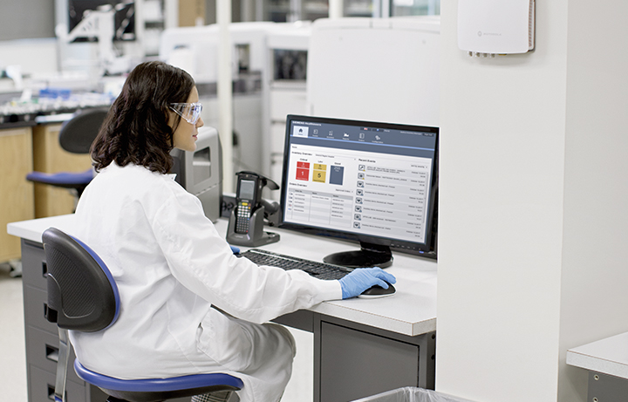
Table of Contents Data Lake Questionnaire
Introduction 4
Topics in the questionnaire
Background information 6 Legal Basis of Data Use 7
Citation/Disclosure Requirements 8
Personal data 9
Need-to-know Principle/Confidentiality 11
Local Residency Requirements 13
Period of Storage and Use 14
Other Use Restrictions 15
Further Information 17

Slide 4
Data Lake Questionnaire Introduction
Scope & Purpose
Instruments/Devices from Siemens Healthineers have the ability to collect data about utilization, performance, potential maintenance and errors. This information is transferred into the network of Siemens Healthineers and analysed and processed to fulfil the contracted service deliverables.
All data that is collected and stored within Siemens Healthineers needs to be “enriched” by some additional information which is, typically, not part of the data itself.
This additional data (=meta data) contains information e.g. about the data owner, the origin of the data and the contractually agreed intended use.
The purpose of this training is to give all customers of the teamplay Data Lake some guidance while filing in the information that is mandatory to have for storing and distributing the data in a legal and compliant way in regards to requirements defined by legal and data protection. Foundation of the requirements are the currently know laws and regulations like: HIPPA , GDPR, DSGVO, etc.

Slide 5
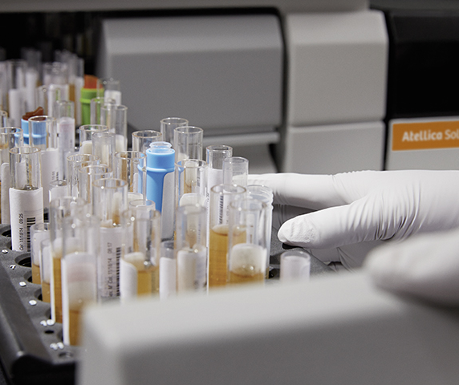
Data Lake Questionnaire Introduction
teamplay Data Lake is a cloud based (Microsoft Azure) storage space for all incoming structured & unstructured data. It is designed to store all kind of data in a legal and regulatory compliant way. The teamplay Data Lake can be used to store and distribute data within Siemens Healthineers or outside customers. In addition, the teamplay Data Lake can be used as a long-term archive.

Slide 6
Topics of the questionnaire 1. Background information
Needed Information about:
Data source, ownership and content
Name of the (sub-)project or initiative
Data Owner @Healthineers
Data source link
Third party data source
HDP/Comfor ID
Specify privacy profile
Public or private Data Contract
Other
Expected information:
The answers in this section help the tp Data Lake to establish the right environment for the data (size & security). All information is needed to ensure that tp Data Lake has on the one hand an appropriate contact to get back in case of issues and on the other hand all information about the origin of the data. This will help to trigger the correct distribution of the data and the replication between the reginal data centers were the tp Data Lake is located.
HDP/Comfor ID and privacy profiles are optional information
For sensitive data the Data Contract (the electronic version of the information provided in the teamplay questionnaire) can be marked private, means the information that this kind of data is available within Healthineers will not appear in any Data Catalogue or search answer.

Slide 7
Topics of the questionnaire 2. Legal Basis of Data Use
Needed Information about:
Contract with customer
Contract with supplier
Unilateral authorization
None required
Expected answer:
Choose which agreement is the foundation of the data collection.
Explanation of what agreement is the basis for the data collection. Please include a link to the relevant documents.
If no contractual basis is needed, please explain the reasons.

Slide 8
Topics of the questionnaire 3. Citation/Disclosure Requirements
Needed Information about:
Is there a requirement to cite the origin of the data?
Is there a requirement to disclose any results generated by the data use?
Any other similar requirements?
This information enables Healthineers to comply with citation or disclosure obligations based on contracts or applicable laws. Missing or incorrect information may lead to a breach of contract or applicable laws on the part of Healthineers and to payment of fines.
Expected answer
Are there any laws or regulations that require tp Data Lake to always state the origin of the data even after the original data was processed?
Can the results that are generated from the original data or with the help of the data be distributed without limitations or used in other contexts?
Are there any other specific limitations that come along with the data that limit the usage or distribution of the data?

Slide 9
Topics of the questionnaire 4. Personal Data (1)
This information enables the tp Data Lake to qualify personal data correctly and is required for handling, storing and distributing such data in a compliant way. This information is crucial for administering the data. Missing or incorrect information as to the legal basis of data use may lead to the data set becoming unusable and/or to Siemens Healthineers having to pay high fines.
Needed Information about:
Are you processing personal data?
Is the data considerd to be “sensitive data” under applicable laws, E.g. genetic data, biometric data, health data, racial or ethnic origin, political opinion, religious or philosophical beliefs, or trade union membership, data concerning a natural person’s sex life or sexual orientation, or is the data specifically protected by law for any other reason?
Expected answer
Data relating to an identified or identifiable person is any information that can be allocated to a specific person, possibly in conjunction with other information.
Health data may comprise inter alia DICOM pictures, information about the disease of a person, examination results, blood pressure, etc.
Whenever data is marked to be personal/sensitive data this data will be excluded for the regular spot checks for personal/sensitive data.

Slide 10
Topics of the questionnaire 4. Personal Data (2)
Needed Information about:
Has the data been minimized in a way that the identification of a person is rendered as difficult as possible, given the requirements of the permitted purpose of processing?
Does the data to be uploaded contain data which originally were relating to a person identified or identifiable (i.e. subject to 4.1.) but has subsequently been anonymized?
Was this anonymization performed by means of tools approved by SHS DP?
In which role does SHS process the data?
Expected answer
It must be ensured that the tp Data Lake contains personal data only to the extent which is necessary for the permitted purpose of the relevant processing of data (including its upload into the tp Data Lake). The “cleaning/minimization” of data can be done by tools that search for sensitive data and delete or overwrite it.
Data that had originally contained personal/sensitive data but was modified before it was uploaded to tp Data Lake so that the identification of the person is made impossible with the currently known technologies is called “anonymized”. Anonymization may be achieved by removing all identifiers so that the data does not permit the identification of a person or patient, even in conjunction with other information available within or outside the tp Data Lake.
Was the Anonymization done by tools from Siemens Healthineers (developed or purchased) or before it was transferred to SHS .
In case SHS is the “controller” of the data it may, if the contract permits be used for a variety of tasks/analysis. If SHS is only the “processor” the usability is limited to just the exactly agreed upon intended use.

Slide 11
Topics of the questionnaire 5.1 Need to know principle/confidentiality
Needed Information about:
Is the data subject to an NDA or a confidentiality clause?
Is the data subject to the “need-to-know principle”?
Expected answer
Does the agreement with an outside customer/supplier contain an NDA or any comparable confidentiality clause?
Can the obtained data be shared with everybody inside Siemens Healthineers or is the access restricted to those employees that need access to the data to perform the contracted business case?

Slide 12
Topics of the questionnaire 5.2 Need to know principle/confidentiality
Needed Information about:
Are you processing the data only inside the EU
If so, who is permitted to receive and access the data?
Can the data be shared with the entire Siemens Healthineers Group?
Or only with specific departments
Third parties
Selected Affiliates
All subsuppliers/consultants
Is it allowed to share the data with suppliers
All
Only selected
Customers
Is it allowed to share the data with customers
All
Only selected
Expected answer
If the data is processed inside the EU only, GDPR as one of the strongest Data Protection laws applies for the storage and processing of the data.
It must be ensured that the tp Data Lake allows access to stored data only if the Data Owner allows the sharing of data.

Slide 13
Topics of the questionnaire 6. Local Residency Requirements
Needed Information about:
Is there a requirement that a copy of the data must be stored locally in a country, region or other location (but may also be retained elsewhere)?If “Yes”- where does this requirement apply?
Is there a requirement that data may only be stored and retained data locally in a certain country, region or other location? If “Yes”- where does this requirement apply?
Expected answer
tp Data Lake data will only be stored in the cloud (mainly EU). Please specify if an additional local or regional copy is required. This is a legal requirement in some contries
If data may only be stored and processed in a specific country or region, please specify this requirement here.

Slide 14
Topics of the questionnaire 7. Period of Storage and Use
Needed Information about:
Is the data subject to a minimum retention obligation?
Can the data be used with limit in time? If ”Yes”- when does the period end?
Applicable for application archive storage: should the data and all its versions be prevented from deletion
Expected answer
Internal regulations reg. retention need to be taken into consideration. tp Data Lake will store the data for the mentioned time period automatically. Afterwards the Data Owner will be notified and can then chose to delete the data or store it for a longer period of time.
E.g. time permitted is agreed upon in a collaboration agreement. Data will automatically be deleted after the specifies period ends. Data Owner will be notified in advance.
tp Data Lake offers the service to prevent data from being deleted by accident. This applies to archive storage only!

Slide 15
Topics of the questionnaire 8. Other Use Restrictions (1)
Needed Information about:
Scientific/academic/educational purpose:
Purpose restrictions because of
Contractual performance
Commercial/business purposes
Specific project
In general
Development purposes
Specific project
In general
Research purposes
Specific project
In general
Expected answer
Is the uploaded/stored data used for scientific research, education or other collaboration with educational bodys (e.g. university hospitals)?
Please specify the contract that defines the restrictions for the usage of the data
Can the data be used for a specific project only
Or for all purposes
Can the data be used for a specific project only
Or for all purposes
Can the data be used for a specific project only
Or for all purposes

Slide 16
Topics of the questionnaire 8.3 Other Use Restrictions (3)
Needed Information about:
Geographical use restrictions :
Specific Countries
Other
Other use restrictions
Expected answer
As there any restrictions that permit the usage of the data outside of a specific county or region? Does this apply to the original data only or does it affect also the usage of the generated results.
Are there any other then the above-mentioned use restrictions that apply for the stored data? For example, deriving from specific license metric which impact data use (number of copies).

Slide 17
Further Information
Links to further information:
Siemens internal
Data Protection
HDP Register
Outside of Siemens:
Landesbeauftragte für Datenschutz und Informationsfreiheit Mecklenburg-Vorpommern
EU GDPR site
Psydonymisierung - Mainzelliste
Data Privacy (sharepoint.com)
Home | Healthineers Data Privacy Register (siemens.com)
https://www.datenschutz-mv.de/datenschutz/datenschutzmodell/
https://ec.europa.eu/info/law/law-topic/data-protection_en
http://www.unimedizin-mainz.de/imbei/informatik/ag-verbundforschung/mainzelliste.html

